Slide 1

INSTITUTE - UIE
DEPARTMENT- ACADEMIC UNITS
Bachelor of Engineering (Computer Science & Engineering)
Subject Name: Elementary Data Structure Using C++
Code:23CSH-103
Arrays
DISCOVER . LEARN . EMPOWER

Slide 2


Elementary Data Structure Using C++
Course Objectives
To enable the students to understand various stages and constructs of C++ programming language.
To improve their ability to analyze and address variety of problems in C++.
To understand the concept of data structures and various operations on them.
To understand the properties of various data structures and able to identify the strengths and weaknesses of different data structures.
To analyze and compare the efficiency of algorithms and learn to design efficient algorithms for solving computing problems

Slide 3



Course Outcomes
CO Number | Course Outcome
CO1 | Understand the concepts of object-oriented programming including programming process and compilation process.
CO2 | Apply different techniques to decompose a problem and programmed a solution with various concepts of object-oriented programming language.
CO3 | Analyse and explain the behaviour of linear data structure operations using the programming addressed in the course.
CO4 | Implement and evaluate the programs using the syntax and semantics of object-oriented programming.
CO5 | Design the solution of real-world problems in order to determine that the program performs as expected.

Slide 4

Scheme of Evaluation

Slide 5
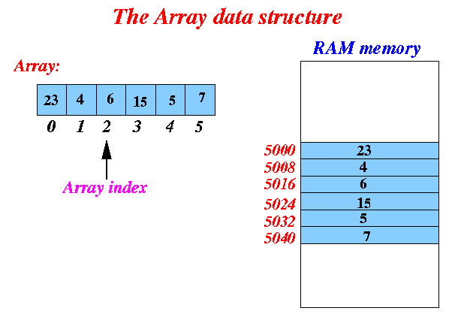
Arrays
An array is a collection of items stored at contiguous memory locations. The idea is to store multiple items of the same type together.
This makes it easier to calculate the position of each element by simply adding an offset to a base value, i.e., the memory location of the first element of the array (generally denoted by the name of the array).
http://www.mathcs.emory.edu/~cheung/Courses/171/Syllabus/1-intro/rev=arrays.html

Slide 6
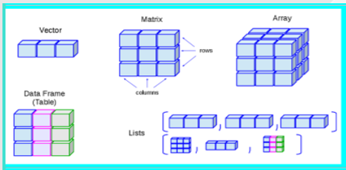
Arrays
Linear arrays are called one dimensional arrays because each element in such an array is referenced by one subscript.
(Two dimensional array) : Two dimensional array is a collection of similar data elements where each element is referenced by two subscripts.
Such arrays are called matrices in mathematics.
Multidimensional arrays are defined analogously
Array Data Structure
It can hold multiple values of a single type.
Elements are referenced by the array name and an ordinal index.
Each element is a value.
Indexing begins at zero in C.
The array forms a contiguous list in memory.
https://www.chegg.com/homework-help/questions-and-answers/matrix-array-vector-rows-data-frame-table-columns-lists-r-data-types-true-true-true-true-f-q28713018

Slide 7
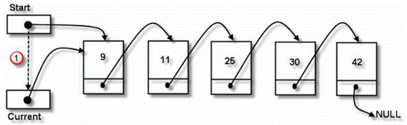
Traversing linear Arrays
Print the contents of each element of DATA or Count the number of elements of DATA with a given property. This can be accomplished by traversing DATA, That is, by accessing and processing (visiting) each element of DATA exactly once.
Traversing a linear structure means moving through it sequentially, node by node. Processing the data element of a node may be complex, but the general pattern is as follows:
Begin at the first node
Repeat until there are no more nodes
Process the current node
Move to the next node
https://www.sqa.org.uk/e-learning/LinkedDS02CD/page_46.htm

Slide 8
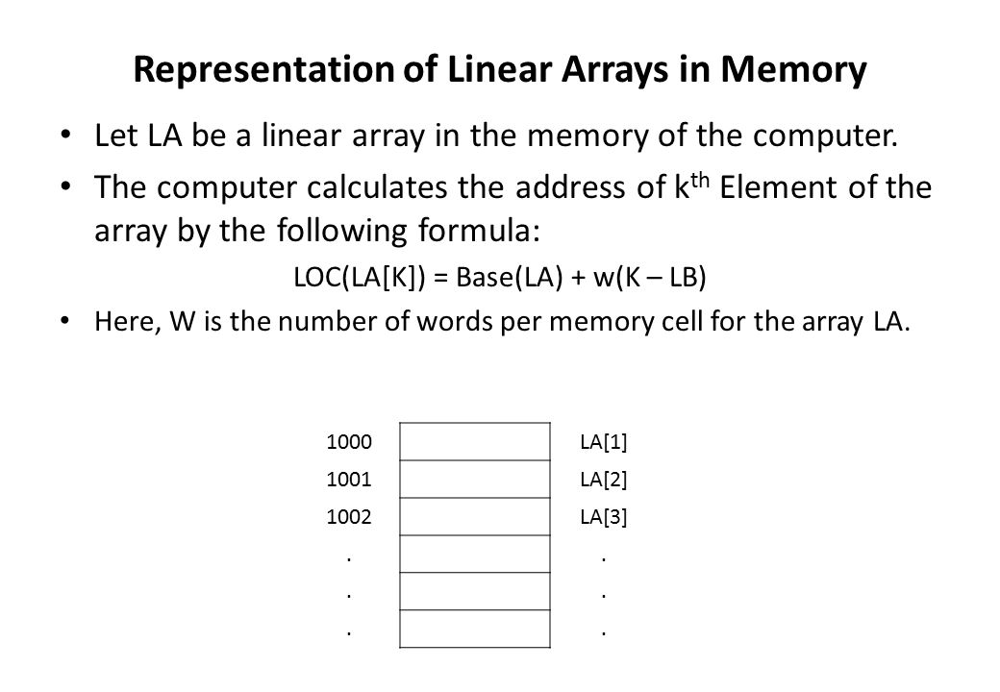
Representation of linear array in memory
To implement array data structure, memory bytes must be reserved and the accessing functions must be coded. In case of linear arrays, the declaration statements tell how many cells are needed to store the array.
Each box represents the amount of memory needed to hold one array element.
Pointers hold the memory address of other data and are represented by a black disk with an arrow pointing to the data it references.
The actual array variable, a in this example, is a pointer to the memory for all of its elements.
https://slideplayer.com/slide/7853049/

Slide 9
Traversing Linear Arrays
Example :
An automobile company uses an array AUTO to record the number of auto mobile sold each year from 1932 through 1984.
a) Find the number NUM of years during which more than 300 automobiles were sold.
b) Print each year and the number of automobiles sold in that year.
Set NUM : = 0.
Repeat for K = 1932 to 1984:
if AUTO[K]> 300, then : set NUM : = NUM+1
Exit.

Slide 10
Insertion in an Array
INSERTING AN ELEMENT INTO AN ARRAY:
Insert (LA, N, K, ITEM)
Here LA is linear array with N elements and K(position) is a positive integer such that K<=N.
This algorithm inserts an element ITEM into the Kth position in LA.
ALGORITHM
Step 1 [Initialize counter] Set J:=N
Step 2 Repeat Steps 3 and 4 while J>=K
Step 3 [Move Jth element downward] Set LA [J+1]: =LA [J]
Step 4 [Decrease counter] Set J:=J-1
[End of step 2 loop]
Step 5 [Insert element] Set LA [K]: =ITEM
Step 6 [Reset N] Set N:=N+1
Step 7 Exit

Slide 11
Deletion from an Array
DELETING AN ELEMENT FROM A LINEAR ARRAY
Delete (LA, N, K, ITEM)
Here LA is a linear array with N elements and k is a positive integer such that K<=N. This algorithm deletes the Kth element from LA.
ALGORITHM
Step 1 Set ITEM: = LA [K]
Step 2 Repeat for steps 3&4 for J=K to N-1:
Step 3 [Move J+1st element upward] Set LA [J]: =LA [J+1]
Step4 [Increment counter] J=J+1
[End of step2 loop]
Step 5 [Reset the number N of elements in LA] Set N:=N-1
Step 6 Exit

Slide 12
Linear & Binary Search
Linear Search :
Best Case: Find at first place - one comparison
Average case: There are n cases that can occur, i.e. find at the first place, the second place, the third place and so on up to the nth place.
average = (1+2+3.....+n)/n = n(n+1)/2n=(n+1)/2
where the result was used that 1+2+3 ...+n is equal to n(n+1)/2.
Worst case: Find at nth place or not at all - n comparisons
Binary Search:
Algorithm: Binary(DATA,LB,UB,ITEM): Here data is a sorted array with lower bound LB and upper bound UB and ITEM is an element to be searched. The variables BEG,END and MID denote, resp, the beginning, end and middle locations of a segment of elements of DATA. This algorithm find the location LOC of ITEM in DATA or sets LOC=NULL.

Slide 13
Searching – Linear Search Algorithm
Linear Search :
Algorithm : A linear array DATA with N elements and a specific ITEM of information are given. This algorithm finds the location LOC of ITEM in the array DATA or sets LOC = 0.
Set K : = 1, LOC : =0.
Repeat steps 3 and 4 while LOC = 0 and K<=N:
If ITEM = DATA[K], then : Set LOC : =K .
Set K : = K+1.
[End of step 2 loop]
[Successful?]
If LOC = 0, then :
Write : ITEM is not in the array DATA.
Else :
Write : LOC is the location of ITEM.
[End of if structure]
Exit.

Slide 14
Binary Search Algorithm
BINARY(DATA, LB, UB, ITEM, LOC)
Set BEG=LB; END=UB; and MID=INT((BEG+END)/2).
Repeat step 3 and 4 while BEG ≤ END and DATA[MID] ≠ ITEM
If ITEM < DATA[MID] then
Set END= MID - 1
Else:
Set BEG= MID+1
[end of if structure]
Set MID= INT((BEG+END)/2)
[End of step 2 loop]
If ITEM = DATA[MID] then
Set LOC= MID
Else:
Set LOC= NULL
[end of if structure]
Exit.

Slide 15
Applications
Array can be used for sorting elements, can perform matrix operation & can be used in CPU scheduling.
Stack is used in Expression evaluation
Disk Scheduling.

Slide 16
Application: Two of the most essential applications performs on an array or a record are searching and sorting.
Searching: Each index in a parallel array corresponds to the data belonging to the same entity in a record. Thus, for searching an entity based on a specific value of an attribute, e.g. we need to find the name of a person having height >200 cms in the above example. Thus, we search for the index in the height array having value greater than 200. Now, once we have obtained the index, we print the values of the index in the first_name and last_name arrays. This way searching becomes an easy task in parallel array.
Sorting: Now, using the same fact that each index corresponds to data items in different arrays corresponding to the same entity. Thus, we sort all arrays based on the same criteria. For example, in the above-displayed example, we need to sort the people in increasing order of their respective heights. Thus, when we swap the two heights, we even swap the corresponding values in other arrays using the same index.

Slide 17
REFERENCES
Lipschutz, Seymour, “Data Structures”, Schaum's Outline Series, Tata McGraw Hill.
Goodrich, Michael T., Tamassia, Roberto, and Mount, David M., “Data Structures and Algorithms in C++”, Wiley Student Edition.
https://www.tutorialspoint.com/data_structures_algorithms/algorithms_basics.htm
https://www.cs.utexas.edu/users/djimenez/utsa/cs1723/lecture2.html
Lipschutz, Seymour, “Data Structures”, Schaum's Outline Series, Tata McGraw Hill.
Lipschutz, Seymour, “Data Structures”, Schaum's Outline Series, Tata McGraw Hill.
Gilberg/Forouzan,” Data Structure with C ,Cengage Learning.
Augenstein,Moshe J , Tanenbaum, Aaron M, “Data Structures using C and C++”, Prentice Hall of India

Slide 18
THANK YOU

